Slide 1
Data Structure and Algorithms --Dynamic Programming
Guangyu Zou
Dalian University of Technology
gyzou@dlut.edu.cn

Slide 2
Outline
Maximum Subarray
Rod Cutting
Dynamic Programming

Slide 3
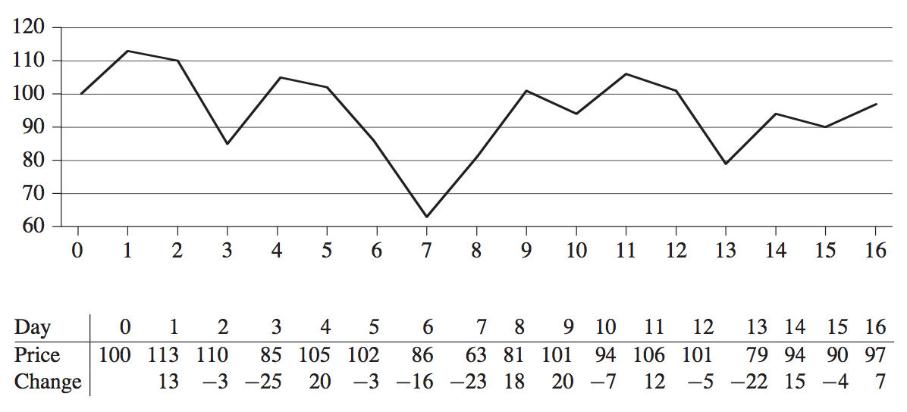
Maximum Subarray

Slide 4
Maximum Subarray
Brutal Force
Divide and Conquer
entirely in the left subarray
entirely in the right subarray
Crossing the middle point

Slide 5
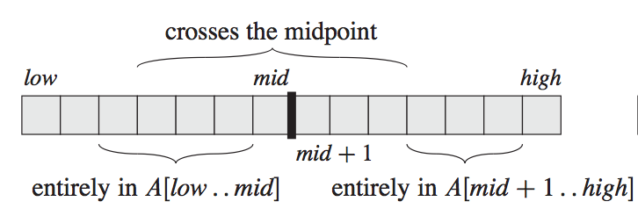
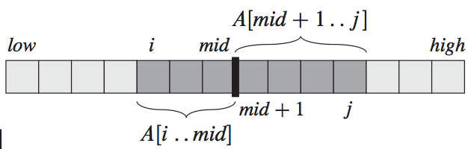
Maximum subarray

Slide 6
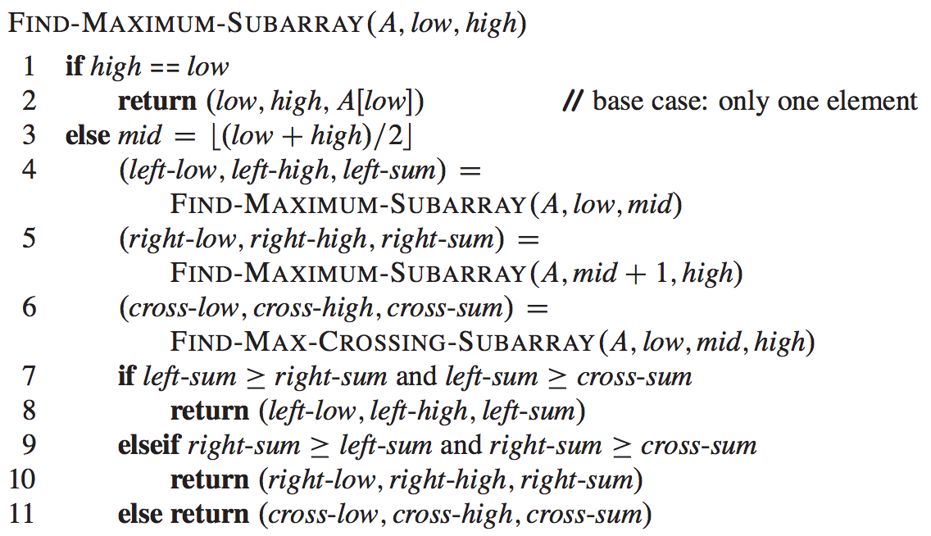
Maximum Subarray

Slide 7
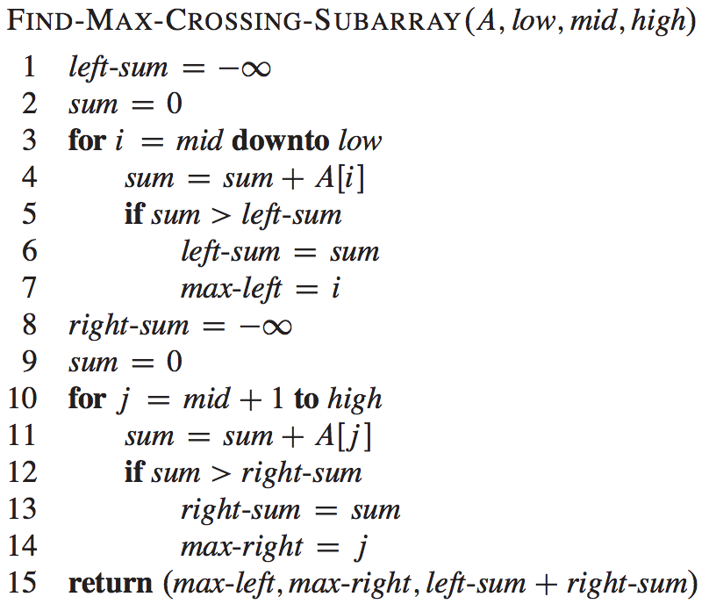

Slide 8
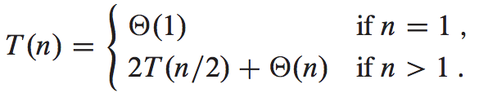
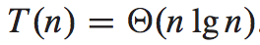
Complexity

Slide 9
DP Approach
dp[i] = max(dp[i-1], prices[i] - lowest);
int maxProfit(int[] prices) {
if (prices.lenth<= 1) return 0;
else {
int[] dp = new int[prices.length];
int tmpMin = prices[0];
for (int i = 1; i < prices.length; i++) {
dp[i] = Math.max(dp[i-1], prices[i] - tmpMin);
tmpMin = Math.min(tmpMin, prices[i]);
}
return dp[prices.length-1];
}
}
O(n)

Slide 10
Thinking Assignments
What is the max profit if at most two transactions are allowed?
What is the max profit if at most k transactions are allowed?
public int maxProfit(int[] prices) {
if (prices.length <= 1)
return 0;
int k = 2;
int[][] dp = new int[k+1][prices.length];
for (int i = 1; i <= k; ++i) {
int tmpMax = dp[i-1][0] - prices[0];
for (int j = 1; j < prices.length; ++j) {
dp[i][j] = Math.max(dp[i][j-1], prices[j] + tmpMax);
tmpMax = Math.max(tmpMax, dp[i-1][j-1]-prices[j]);
}
}
return dp[k][prices.length-1];
}

Slide 11
Thinking Assignments
What is the max profit if as many transactions as possible are allowed?
public int maxProfit(int[] prices) {
if (prices == null || prices.length <= 1)
return 0;
int ret = 0;
for (int i = 1; i < prices.length; ++i) {
if (prices[i]-prices[i-1] >= 0)
ret += prices[i] - prices[i-1];
}
return ret;
}

Slide 12
Dynamic Programming
Previous divide-and-conquer algorithms partition the problem into disjoint subproblems, solve the subproblems recursively, and then combine their solutions to solve the original problem.
In contrast, dynamic programming applies when the subproblems overlap—that is, when subproblems share subsubproblems.
A dynamic-programming algorithm solves each subsubproblem just once and then saves its answer in a table, thereby avoiding the work of recomputing the answer every time it solves each subsubproblem.

Slide 13
Applications of DP
We typically apply dynamic programming to optimization problems.
Such problems can have many possible solutions. Each solution has a value, and we wish to find a solution with the optimal (minimum or maximum) value.
We call such a solution an optimal solution to the problem, as opposed to the optimal solution, since there may be several solutions that achieve the optimal value.

Slide 14
Four steps
Characterize the structure of an optimal solution.
Recursively define the value of an optimal solution.
Compute the value of an optimal solution, typically in a bottom-up fashion.
Construct an optimal solution from computed information.

Slide 15
Climbing Stairs – leetcode.com
You are climbing a stair case. It takes n steps to reach to the top.
Each time you can either climb 1 or 2 steps. In how many distinct ways can you climb to the top?

Slide 16
Thinking Assignments
What if you can climb up to 3 steps each time?
int climbStairs(int n)

Slide 17
Unique Paths – leetcode.com
A robot is located at the top-left corner of a m x n grid (marked 'Start' in the diagram below).
The robot can only move either down or right at any point in time. The robot is trying to reach the bottom-right corner of the grid (marked 'Finish' in the diagram below).
How many possible unique paths are there?

Slide 18
Unique Paths II – leetcode.com
Now consider if some obstacles are added to the grids. How many unique paths would there be?
An obstacle and empty space is marked as 1 and 0 respectively in the grid.
[
[0,0,0],
[0,1,0],
[0,0,0]
]
In place?

Slide 19
Dungeon Game – leetcode.com
The demons had captured the princess (P) and imprisoned her in the bottom-right corner of a dungeon. The dungeon consists of M x N rooms laid out in a 2D grid. Our valiant knight (K) was initially positioned in the top-left room and must fight his way through the dungeon to rescue the princess.

Slide 20
Dungeon Game
The knight has an initial health point represented by a positive integer. If at any point his health point drops to 0 or below, he dies immediately.
Some of the rooms are guarded by demons, so the knight loses health (negative integers) upon entering these rooms; other rooms are either empty (0's) or contain magic orbs that increase the knight's health (positive integers).
In order to reach the princess as quickly as possible, the knight decides to move only rightward or downward in each step.

Slide 21
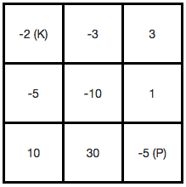
Dungeon Game

Slide 22
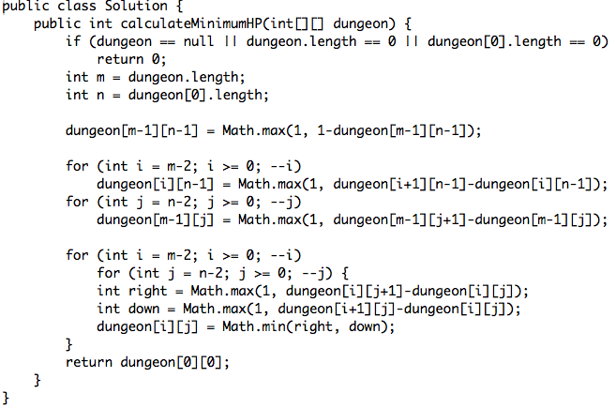

Slide 23
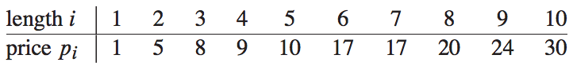
Rod cutting
The rod-cutting problem is the following. Given a rod of length n inches and a table of prices p_{i} for i = 1, 2, ……, n, determine the maximum revenue r_{n} obtainable by cutting up the rod and selling the pieces.

Slide 24
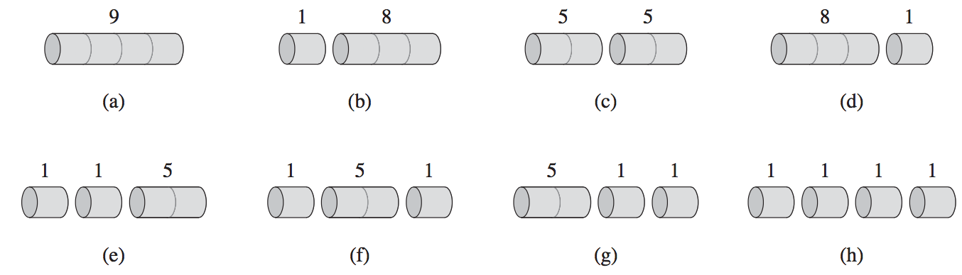
Example
The 8 possible ways of cutting up a rod of length 4.
How many ways to cut a rod of length n?
2^{n-1}

Slide 25
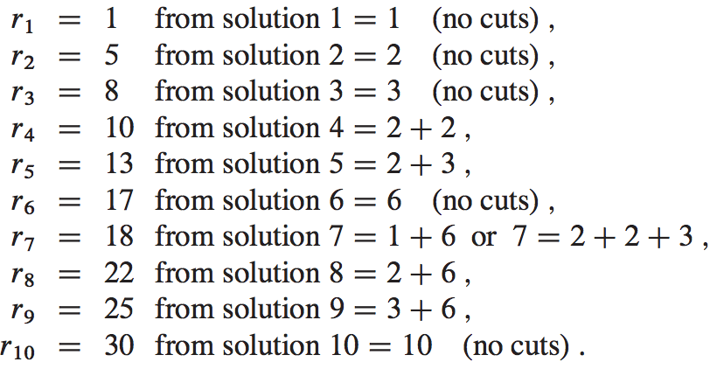
Recursion

Slide 26
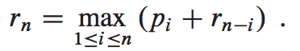
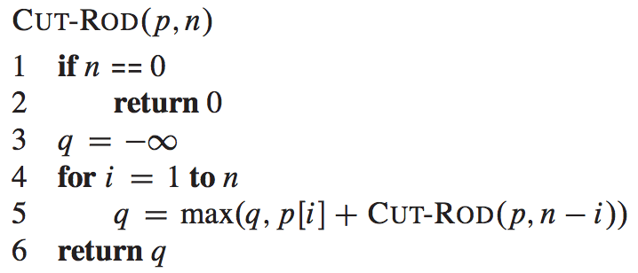
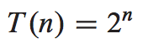
Recursive top-down implementation

Slide 27
Using dynamic programming for optimal rod cutting
Top-down with memoization.
In this approach, we write the procedure recursively in a natural manner, but modified to save the result of each subproblem (usually in an array or hash table). The procedure now first checks to see whether it has previously solved this subproblem. If so, it returns the saved value, saving further computation at this level; if not, the procedure computes the value in the usual manner. We say that the recursive procedure has been memoized; it “remembers” what results it has computed previously.

Slide 28
Using dynamic programming for optimal rod cutting
Bottom-up method.
This approach typically depends on some natural notion of the “size” of a subproblem, such that solving any particular subproblem depends only on solving “smaller” subproblems. We sort the subproblems by size and solve them in size order, smallest first. When solving a particular subproblem, we have already solved all of the smaller subproblems its solution depends upon, and we have saved their solutions. We solve each subproblem only once, and when we first see it, we have already solved all of its prerequisite subproblems.

Slide 29
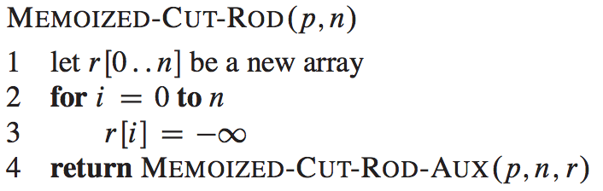
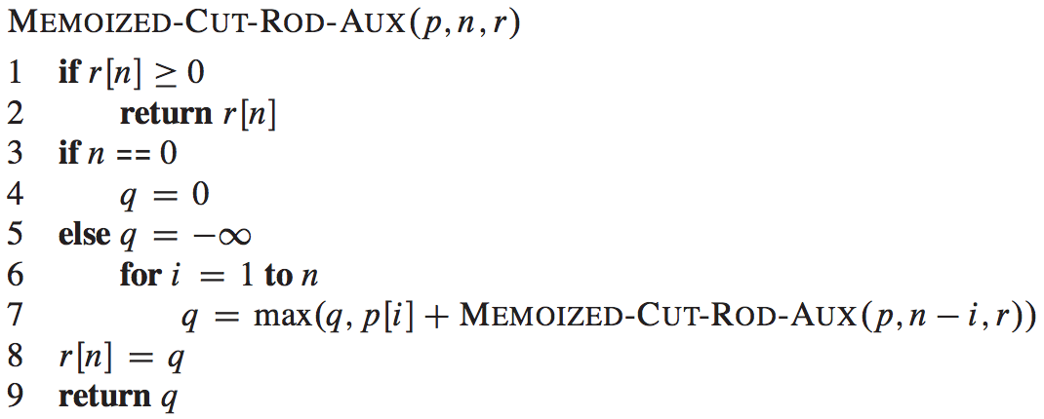
Top-down with memory

Slide 30
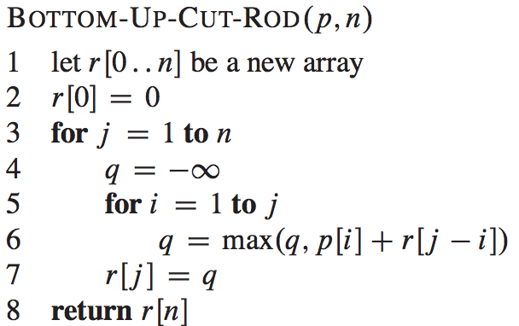
Bottom-up
O(n²)

Slide 31
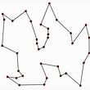
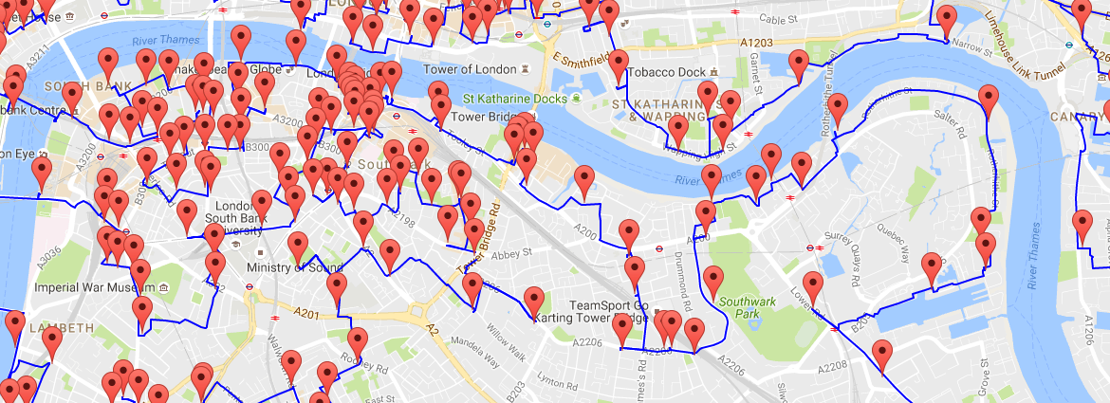
TSP
Travelling Salesman Problem (TSP): Given a set of cities and distance between every pair of cities, the problem is to find the shortest possible route that visits every city exactly once and returns to the starting point.

Slide 32
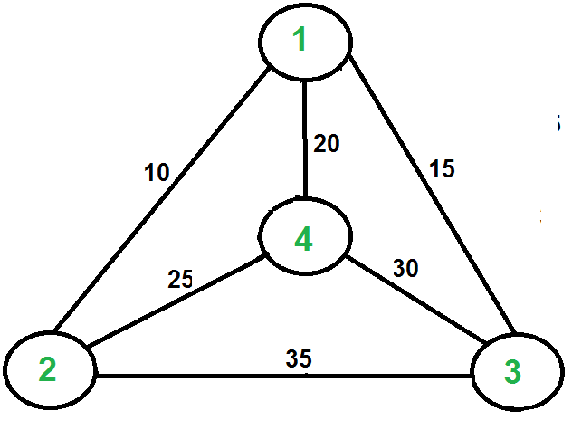
TSP
Consider the graph shown below. A TSP tour in the graph is 1-2-4-3-1. The cost of the tour is 10+25+30+15 which is 80.

Slide 33
Naive Solution
Consider city 1 as the starting and ending point.
Generate all (n-1)! Permutations of cities.
Calculate cost of every permutation and keep track of minimum cost permutation.
Return the permutation with minimum cost.
Time Complexity:
Θ(n!)

Slide 34
Permutation
void permutation(StringBuffer orig, StringBuffer dest, int pos) {
if (pos == dest.length()) {
System.out.println(dest);
return;
}
for (int i = 0; i < orig.length(); i++) {
dest.setCharAt(pos, orig.charAt(i));
orig.deleteCharAt(i);
permutation(orig, dest, pos+1);
orig.insert(i, dest.charAt(pos));
}
}

Slide 35
Dynamic Programming
Given set of vertices {1, 2, 3, 4,….n}, let us consider 1 as starting and ending point of output. For every other vertex i (other than 1), we find the minimum cost path with 1 as the starting point, i as the ending point and all vertices appearing exactly once.
Define a term C(S, i) be the cost of the minimum cost path visiting each vertex in set S exactly once, starting at 1 and ending at i.

Slide 36
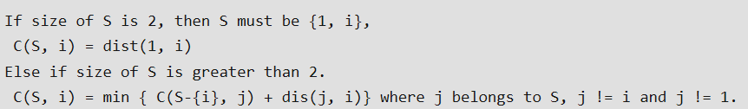
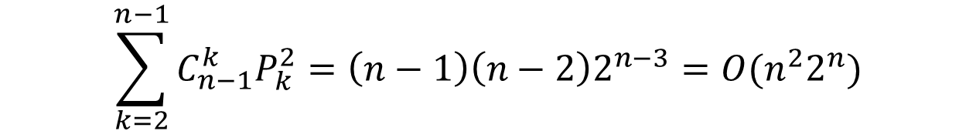
Dynamic Programming
$$\sum_{k=2}^{n−1}{C_{n−1}^{k}P_{k}^{2}}=\left(n−1\right)\left(n−2\right)2^{n−3}=O(n^{2}2^{n})$$

Slide 37
TSP with Constraints
TSP with capacity limit, also named Capacitated VRP(CVRP)
TSP with a time window, also named VRP with Time Windows (VRPTW)
TSP with visiting sequence, also named VRP with Pick-up and Delivery (PDP)

Slide 38
Concepts
In mathematics, a combination is a selection of items from a collection, such that the order of selection does not matter.
In mathematics, the notion of permutation relates to the act of arranging all the members of a set into some sequence or order, or if the set is already ordered, rearranging (reordering) its elements, a process called permuting.

Slide 39
Permutation vs. Combination
void permutation(StringBuffer orig, StringBuffer dest, int pos) {
if (pos == dest.length()) {
System.out.println(dest);
return;
}
for (int i = 0; i < orig.length(); i++) {
dest.setCharAt(pos, orig.charAt(i));
orig.deleteCharAt(i);
permutation(orig, dest, pos+1);
orig.insert(i, dest.charAt(pos));
}
}
ab
ac
ba
bc
ca
cb

Slide 40
Permutation vs. Combination
void Combination(StringBuffer orig, StringBuffer dest, int pos) {
if (pos == dest.length()) {
System.out.println(dest);
return;
}
while (orig.length() != 0) {
dest.setCharAt(pos, orig.charAt(0));
orig.deleteCharAt(0);
Combination(new StringBuffer(orig), dest, pos+1);
}
}
ab
ac
bc

Slide 41
Coins Combination
Coins consist of 1, 2, and 5.
What are solutions to form 15 by combining coins?
1 1 1 1 1 1 1 1 1 1 1 1 1 1 1
1 1 1 1 1 1 1 1 1 1 1 1 1 2
1 1 1 1 1 1 1 1 1 1 1 2 2
1 1 1 1 1 1 1 1 1 1 5
1 1 1 1 1 1 1 1 1 2 2 2
1 1 1 1 1 1 1 1 2 5
1 1 1 1 1 1 1 2 2 2 2
1 1 1 1 1 1 2 2 5
1 1 1 1 1 2 2 2 2 2
1 1 1 1 1 5 5
1 1 1 1 2 2 2 5
1 1 1 2 2 2 2 2 2
1 1 1 2 5 5
1 1 2 2 2 2 5
1 2 2 2 2 2 2 2
1 2 2 5 5
2 2 2 2 2 5
5 5 5
The total number of solutions is 18

Slide 42
Coins Combination
int CoinsCombination(const vector<int>& options, vector<int> solution, int total) {
if (total == 0) {
for (int coin : solution)
cout<<coin<<" ";
cout<<endl;
return 1;
} else if (total < 0)
return 0;
else {
int result = 0;
for (int coin : options) {
if (!solution.empty() && solution.back() > coin)
continue;
solution.push_back(coin);
result += CoinsCombination(options, solution, total-coin);
solution.pop_back();
}
return result;
}
}

Slide 43
Coins Combination
int main() {
vector<int> coins;
coins.push_back(1);
coins.push_back(2);
coins.push_back(5);
vector<int> solution;
int numSols = CoinsCombination(coins, solution, 15);
cout<<"The total number of solutions is "<<numSols<<endl;
return 0;
}

Slide 44
The Min Num of Coins Required

